Slide 1
Identifying Action related Dialogue Acts in Meetings
Suhas Sheshadri

Slide 2
Thank You!
Reijo Silander – Seavus Stockholm AB
Johan Boye – Supervisor
Jussi Karlgren – Examiner
Family and Friends

Slide 3
Agenda
Introduction
Previous Work
Methods
Results
Conclusion

Slide 4
Introduction

Slide 5
Introduction
11 million+ business meetings every day in the US alone
Minutes of Meetings (MoM) is generally done manually
Summarization gives only the overall gist
Difficult to track activities or decisions
Analyzing conversational meetings are not straight forward
Notes:
Meetings – general way to exchange information, share knowledge, discuss problems and produce solutions
MoM – on the spot written records
Meeting transcripts can contain Disfluencies, Contractions, Half-spoken words, Spelling mistakes etc.

Slide 6
Introduction
Action related Dialogue Acts are made up of Action Items, Decisions and Ideas
Dialogue Act (DA) – Labeling an utterance
Thesis branched into two sub-tasks
Decision Detection
Dialogue Act Detection
Notes:
Decision != Action
For example, deciding to become a millionaire is absolutely different from actually performing actions in pursuit of it. Just deciding on something does not make it happen.
Idea is just a thought or a suggestion which has the potential to either become a decision or an action.
Dialogue Acts – labels given to utterances based on a combination of pragmatic, semantic and syntactic criterion.

Slide 7
Previous Work

Slide 8
Previous Work
Decision Detection:
Fernandez et al. - Identify decision making dialogue
Two-layer SVM – First to identify Decision DA and second to identify decisions from it
F-score = 0.58
Dialogue Act Detection:
Matthew Purver et al. - Identify sub-dialogue with action items and extract word phrases from them
SVM: Four independent classifier for each Action specific DAs and a super-classifier to identify action items
F-score = 0.51
Notes:
Fernandez et al. used a Binary SVM to first identify the Decision Dialogue Acts and then an other layer of SVM as a super classifier to identify decisions from it.
Purver et al. first identified sub-dialogues where action items were proposed or discussed. Then, extracting word phrases that precisely encapsulate the task they involve.
They used 4 independent classifiers for detection of each Action Item specific Dialogue Acts (AIDA) class and one super classifier to identify the action items from them.
The lower F-scores indicate the complexity of the problem at hand.

Slide 9
Methods

Slide 10
Dataset
AMI Corpus - 100+ hours of multi-party meetings with manual transcripts, freely available
Scenario based synthetic meetings
Decisions and Dialogue Acts are annotated using a pre-defined set of guidelines
Sometimes, they can contain word phrases which do not impart any value to the label
Notes:
AMI – Augmented Multi-party Interactions
Participants play different role in a design team
A set of statements are together identified as part of a decision Can contain filler statements like ‘hmm’ or neutral statements like ‘May be’

Slide 11
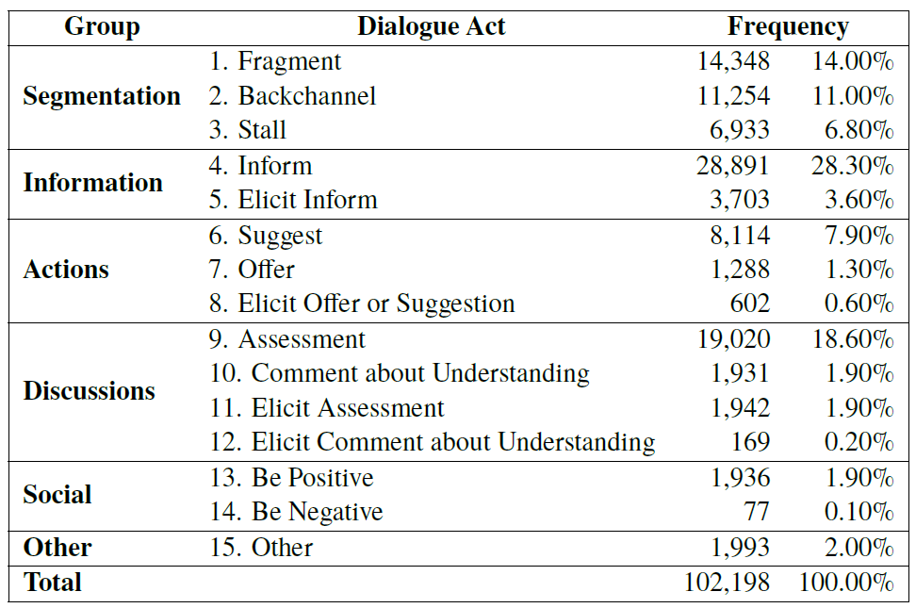
Dialogue Acts - Schema
Word phrase identified as one of fifteen Dialogue Acts
One sentence is assigned to exactly one Dialogue Act
Generalized into six groups
Notes:
No multi-labels
Focus of this thesis is on the ‘Actions’ group

Slide 12
Light Gradient Boosting Machine (LGBM)
Fast, distributed, high performance gradient boosting framework, by Microsoft
Differs from other algorithms in the way which they grow. LGBM grows vertically or leaf-wise
Hyper-parameters tuned for Accuracy
This thesis implements LGBM for comparing different methods
Notes:
*Other Algorithms – Grows horizontally – covering all the nodes at a given level before going to the next level

Slide 13
Bidirectional Encoder Representations from Transformers (BERT)
Deeply bidirectional, self-supervised language representation, pre-trained using only a plain text corpus
Self-attention: Along with the focus on an input token, attention is also given to other words from the same input sequence
Transformer: Sequence to sequence model using self-attention mechanism. Enables the model to learn contextual relations
BERT differs from other language models in the way which it is trained
Notes:
Self-supervised – labels for each word are already present in the form of its surrounding words. This eliminates the need for human annotation.
For a given sequence, Transformers compare each word to every other word and computes the Attention scores.

Slide 14
Bidirectional Encoder Representations from Transformers (BERT)
Pre-training model using two functions:
Masked Language Model
Next Sentence Prediction
Pre-Training: Computationally expensive. Several models are available for download
Thesis uses the BERT_{BASE} Cased pre-trained model
Fine-tuning is comparatively faster and can be adapted to the problem
Notes:
15% of the tokens are masked
Does 2nd sentence follow the 1st or not?
Idea - the ability for the model to learn to relate two distinct sentences to perform downstream tasks
Pre-training took 4 days of 64 TPU’s for Google Researchers

Slide 15
Pre-processing
Conversational meetings are not straight-forward
Disfluency removal (e.g. hm, ah, mh-hmm etc.)
Contraction expanded (you’re -> you are)
Lemmatization
Named Entity Recognition (NER)
Parts of Speech (PoS)
Spelling Correction
Speaker Information
Markers for separating meetings
Notes:
Lemma - Assigning the base forms of words.
NER - Labelling named “real-world” objects, like persons, companies or locations.
PoS - Assigning word types to tokens, like verb or noun.

Slide 16
Training
The tasks of Decision detection and Dialogue Act detection performed using both LGBM and BERT
LGBM took around 30 mins for training
BERT fine-tuning took about 1.5 hours for training ~90K sentences
Notes:
Both were trained on a 12 GB GPU

Slide 17
Post-processing & Summarizing
Ignore all sentences which had less than 5 words
Moving False Negative sentences with less than 8 words to True Negative category
Word phrases like ‘Yeah’, ‘Right’, ‘Okay’
Shorter sentences impart less value
Using Gensim extractive summarizer to obtain an Action Report
Notes:
A lot of False Negative sentences contained phrases like Yeah, Right, Okay
These words are labeled under Segmentation DA for most of the cases and hence BERT did not consider them as part of Actions class

Slide 18
Results

Slide 19
Decision Detection
Both the models performed lower than the current state of the art model with F-score of 0.58
*BC – Binary Classifier
Model | Precision | Recall | F-score | Accuracy
LGBM: BC | 0.24 | 0.75 | 0.31 | 0.53
BERT: BC | 0.53 | 0.04 | 0.08 | 0.77
Notes:
BERT labeled almost all the sentences as ‘Not a Decision’
May be because of the structure of decisions annotated in AMI corpus

Slide 20
Dialogue Acts (1/3)
First, multi-class classifiers were implemented
BERT performed better than LGBM and SVM (F-score of 0.51) *MCC – Multi Class Classifier Classes considered: Segmentation, Information, Actions, Discussions, Social, Other
Model | Precision | Recall | F-score | Accuracy
BERT: MCC-6 | 0.57 | 0.57 | 0.56 | 0.65
LGBM: MCC-6 | 0.29 | 0.68 | 0.41 | 0.48
BERT: MCC-4 | 0.73 | 0.72 | 0.72 | 0.66
LGBM: MCC-4 | 0.34 | 0.70 | 0.46 | 0.51

Slide 21
Dialogue Acts (2/3)
Further, individual classifiers for the important groups were implemented
Future experimentations were continued only on the Actions models
Model | Precision | Recall | F-score | Accuracy
BERT: BC-Information | 0.81 | 0.75 | 0.77 | 0.80
BERT: BC-Actions | 0.78 | 0.74 | 0.76 | 0.91
BERT: BC-Discussion | 0.69 | 0.73 | 0.70 | 0.77
Notes:
Upon checking, Actions class contained all the Action items, Decisions and Ideas

Slide 22
Dialogue Acts (3/3)
The top performing model was: Pre-processing: Disfluency Removal and Contraction Expansion Post-processing: Moving False Negative sentences with less than 8 words to True Negative category
Model | Precision | Recall | F-score | Accuracy
BERT: BC-Actions + PP | 0.83 | 0.90 | 0.86 | 0.95

Slide 23
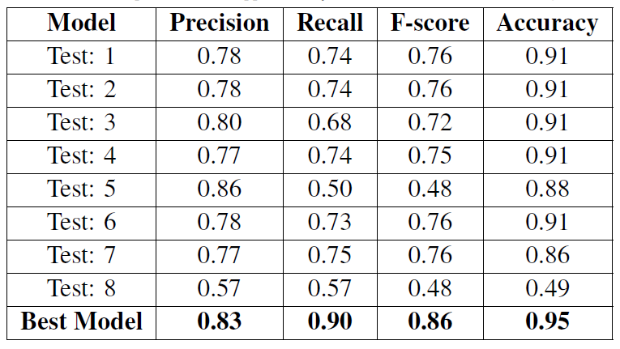
Dialogue Acts – Other experiments
Varying Learning Rate
Varying Epochs
Parts of Speech
Named Entity Recognition
Meeting by Meeting Training
Markings for each meeting
Speaker Info
Ensemble Model
Notes:
Several other experiments were done such as Lemmatizing, Spelling corrections etc.

Slide 24
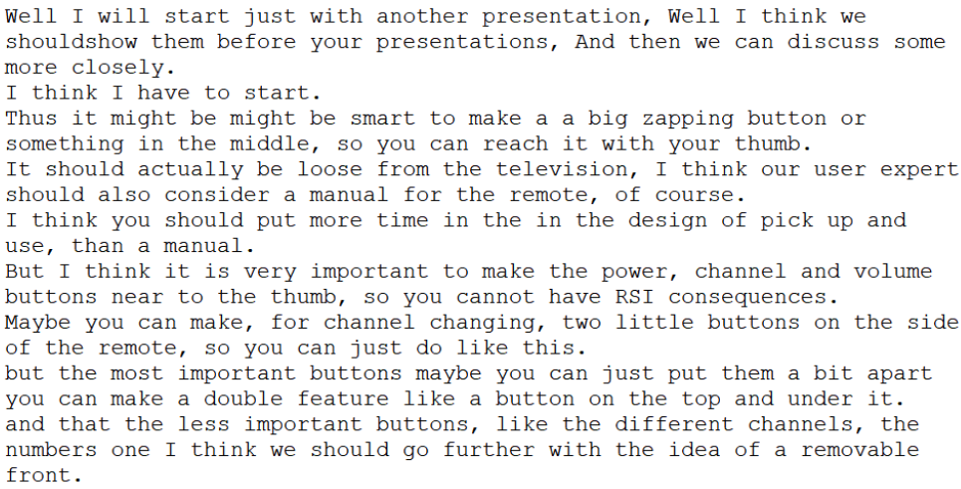
Action Report - Snippet

Slide 25
Conclusion

Slide 26
Conclusion
Using language models, it is possible to identify Action related Dialogue Acts from meeting transcripts
Model with limited pre-processing and minor post-processing worked the best. Might be due to the structure of data considered for pre-training
Most pre-processing techniques resulted in lower performance
For better action reports, an abstractive summarizer would be much suited
Notes:
Wikipedia & BookCorpus has very few contractions and disfluencies.
BERT Large would probably perform better
Data set is 15 years old and limited. Better data may lead to better results.

Slide 27
References
Jean Carletta et al. “The AMI meeting corpus: A pre-announcement”.
Jacob Devlin et al. “BERT: Pre-training of Deep Bidirectional Transformers for Language Understanding”.
Raquel Fernández et al. “Modelling and detecting decisions in multiparty dialogue”.
Matthew Purver et al. “Detecting and Summarizing Action Items in Multi-Party Dialogue”.
Ashish Vaswani et al. “Attention is all you need”.
Guolin Ke et al. “Lightgbm: A highly efficient gradient boosting decision tree”.

Slide 28
Questions?

